Slide 1
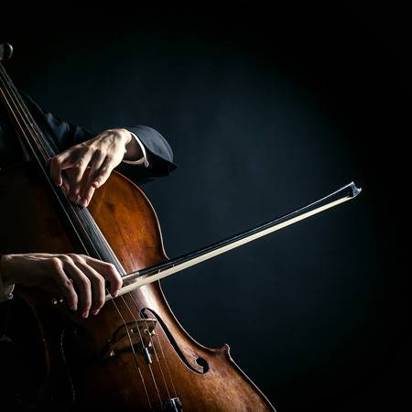

Cello Pitch Recognition using Machine Learning Techniques
Quek Siang Yee
B02170009
Mdm. Nur Erlida Ruslan
Dr. Ong Huey Fang

Slide 2
Introduction
Problem Statement
Objectives
Scope
Significance
Related Works and Comparison
References
Implementation
Result
Research Conclusion
Future Work
Q & A
PROJECT
OUTLINE

Slide 3
Chapter 1
Project Background . Introduction . Problem Statement . Objectives . Scope

Slide 4
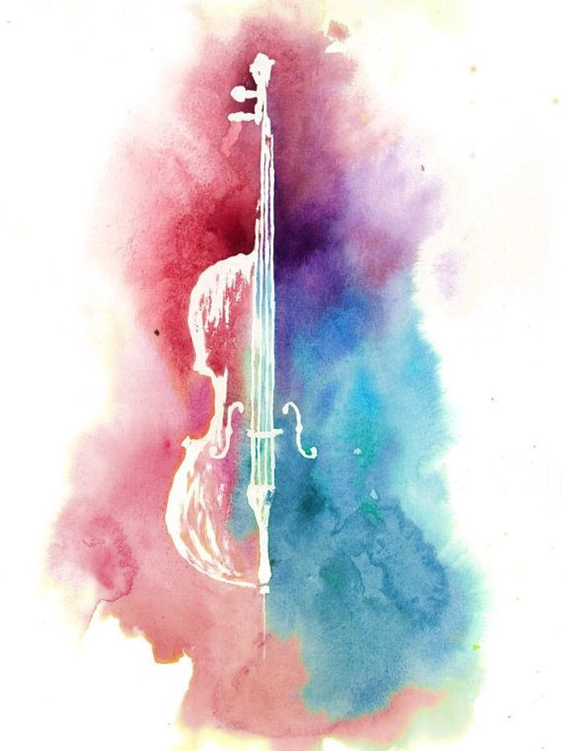
INTRODUCTION on CELLO
Bass instrument
Rate as top 10 easiest musical instrument for beginners
4 strings - C G D A
28 tones
Always in high demand
Fretless fingerboard

Slide 5
INTRODUCTION on PITCH
A certain frequency that can write and read
A particular frequency of sound
A musical/ vocal sound with reference to its pitch, quality and strength
Pitch? Tone? Notes?
Pitch Recognition
An identification process of the highness or lowness of a tone in musical area.

Slide 6
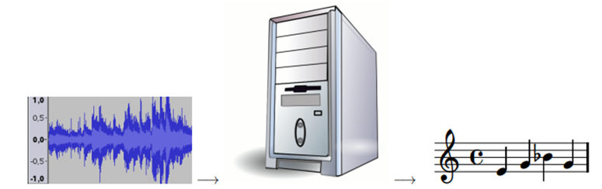
Cello Pitch Recognition
Computer System
Sound Signal
Notes

Slide 7
Problem
Statement
-Similar research projects for stable and discrete sound only. Ex. Piano and Guitar
-Paying high cost to learn a rare ability AP
-Online tutorial can’t help on ensure the pitch is played correctly
-Bad habits on wrong position and inaccurate pitch

Slide 8
How pitch recognizer can be built with machine learning techniques
Objectives
To develop a prototype of pitch recognizer for learning and playing cello music accurately
To test the proposed cello pitch recognizer based on accuracy

Slide 9
Pitch recognizer in strings instrument (cello), music area
Used by anyone who have cello, anyone who like to learn cello, or cellist
Could help user on learning and practise the ability of AP on cello
Use sound recognizer which will help user on learning and practise accurately.
9 tones in total be trained to recognized in this recognizer..
Scope

Slide 10
Chapter 2
Literature Review . Cello . Pitch Recognition . Comparison with similar projects

Slide 11

9 tones included in this study
No | Notes | Position
1 | C2 | Open string on C
2 | G2 | Open string on G
3 | A2 | First finger
4 | A2# | Second finger
5 | D3 | Open string on D
6 | E3 | First finger
7 | F3 | Second finger
8 | F3# | Third finger
9 | A3 | Open string on A

Slide 12
Related Works
Pitch Estimation for Musical Note Recognition using ANN (Jose, 2014)
Pitch Detection Based Monophonic Piano Transcription. (Gao, Pitch Detection)
Musical Pitch Detection using Machine Learning Algorithm. (Bianca, 2014)
SONIC: Transcription of Polyphonic Piano Music with Neural Networks (Marolt, 2000)
Pitch Detection In Polyphonic Music Using Instrument Tone Models (YiPeng Li)

Slide 13
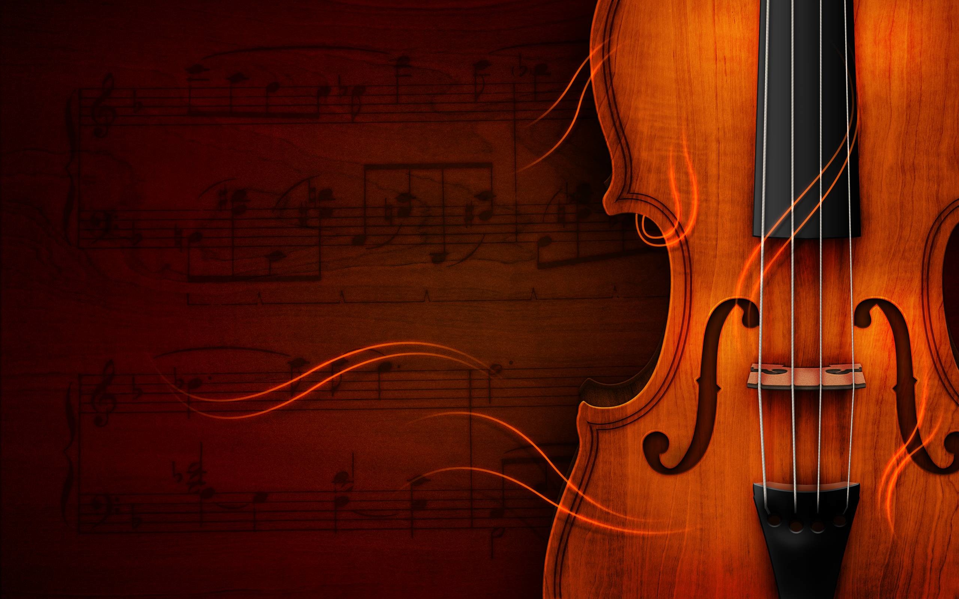
Techniques | Accuracies | Drawback | Tools | Data
ANN | 97.5% | Noise as interference | Neural Lab | Open source database
YIN Algorithm | 96.88% | Not stable |  | Audio Records
SVM | 67.7% |  | NB & LR | Versatile music dataset
TDNN | 92.79% | Lower octave may cause poor performance | SONIC | CD-ROM
HMM | 92.2% | Lower SNR may cause performance | HMM MATLAB | Records from instruments
-
COMPARISON
-

Slide 14
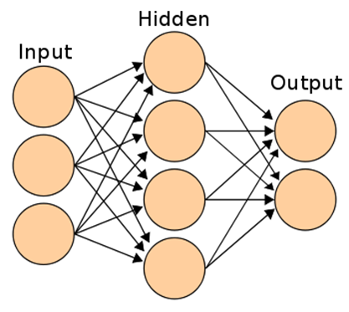
ANNs (Artificial Neural Networks)
Characteristicss
Formed from hundreds of single units
Connected with weights
Build neural structure
Organised in layers
Included 3 layers (input, hidden, output)
Propertise
Trainability
Generalization
Nonlinearity
Robustness
Uniformity
Parallelism
Notes:
-Trainability: Can be taught to form connections between any input and output patterns
Generalization: Don’t just memorize the training data; rather they learn the underlying patterns. So they can generalize from the training data to examples. Important since the cello sound is unstable
Nonlinearity: Networks can compute nonlinear, nonparametric functions of their input, enabling them to perform arbitrary complex transformations of data.
Robustness: tolerant of both physical damage and noisy data
Uniformity: Offer a uniform computational paradigm which can easily integrate constraints from different types of inputs.
Parallelism: Highly parallel in nature, well suited to implementations on massively parallel computers

Slide 15
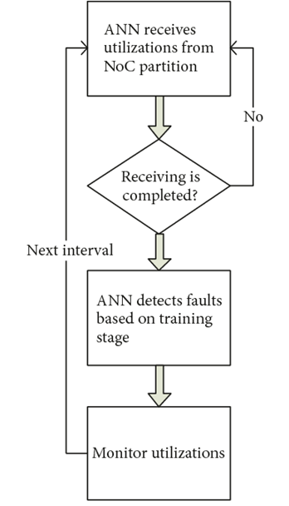
ANNs (Artificial Neural Networks)
How it Works?

Slide 16
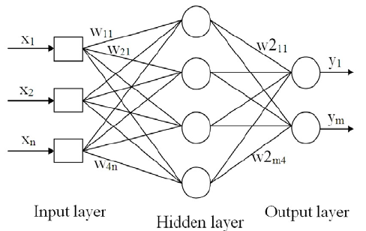
MLP (Multilayer Perceptron)
A feedforward class of ANN. First and simplest type of ANN where contains multiple neurons arranged in layers.
Why use this?
Simplest model in ANN
Ease to understand
Least time to train

Slide 17
Reference of Dataset
GOOD-SOUND DATABASE
- Create in the context of Pablo project
- Included 12 instruments sound file
- Recorded from 15 professional musicians
- Each file in PCM.wav format, 48kHz
- Organized in 4 different table, sound, takes, packs & ratings
Free Sound Database
Free Sound Database
Collaborative database of creative commons licensed
Contains audio snippets, samples, recordings, …….
Started in 2005 in MTG of Barcelona, Spain

Slide 18
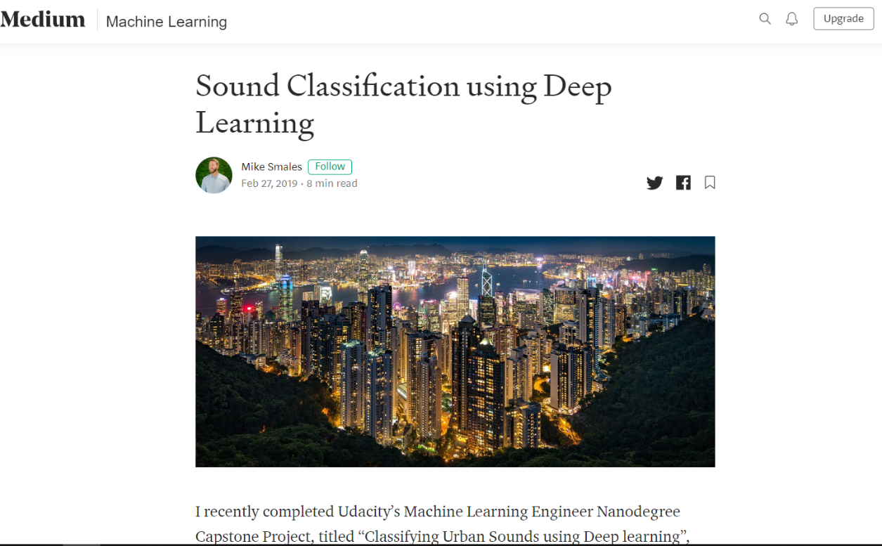
Reference on Building Model
Sound Classification using Deep Learning (Mike Smales)
Recently completed Udacity’s Machine Learning Engineer Nanodegree Capstone Project
Demonstrate project on website (Medium) using AI
Technique he used: MLP and CNN
Classify Urban Sound Datasets, which contain 10 classes
The database contains 8732 labeled sound samples where collected from open source database.

Slide 19
Chapter 3
Methodology . Evaluate model . Software justification . Process of training recognizer

Slide 20
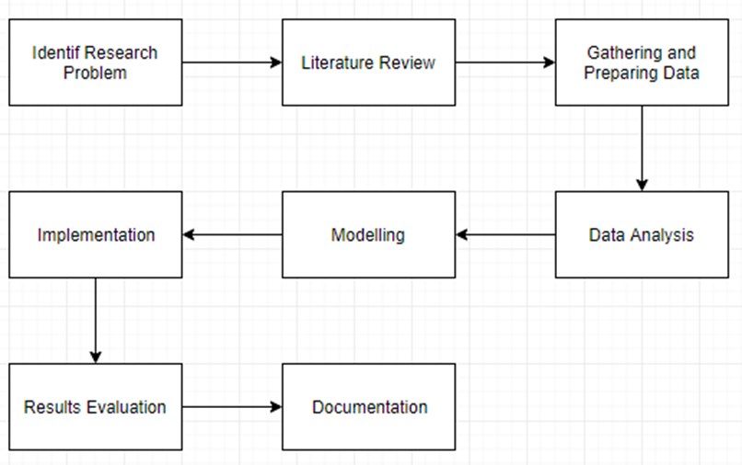
Methodology

Slide 21
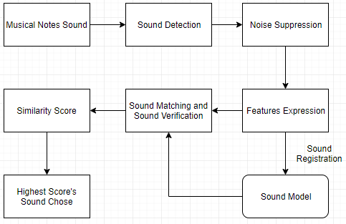
Evaluating Model

Slide 22

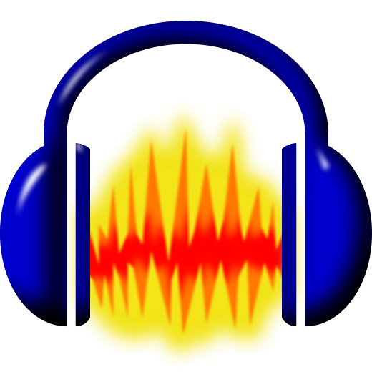


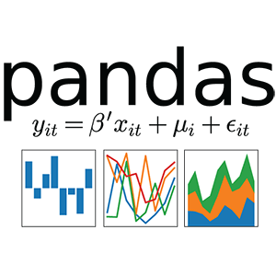


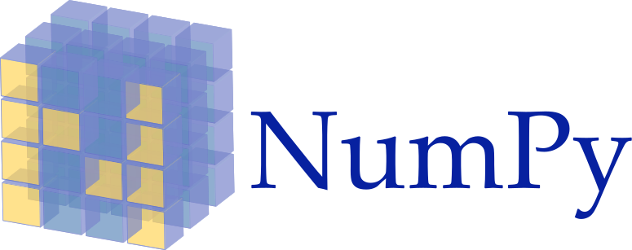



Software Justification
Notes:
Anaconda- open source web application to allow user create and share document contain live code
Jupyter- as ide from analysis to development to evaluate
Audacity- cross platform audio software
Tensorflow- as backend in this study where it is an open source library for numerical computation and large scale machine learning
Keras- library used to builds and train neural network
Librosa- a python module to analyse audio signal in general
Scikit learn- machine learning library for python
Matlotlib- visualization library in python
Pandas- python package providing flexible data structure, a tool kit for data
Library for scientific computing and technical computing used task in calcuus, linear algebra and signall processing
Numpy- package for data manipulation

Slide 23
Chapter 4
Implementation . Proposed Framework . GUI of the system . Details of phases in framework. Process of cello pitch recognition

Slide 24
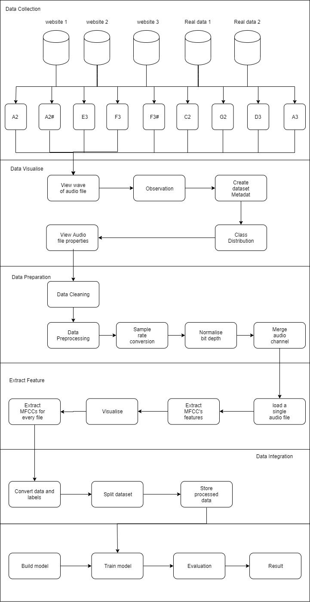
Proposed Framework

Slide 25
Proposed Framework (cont.)

Slide 26
Data Collection
Collect data from 5 Sources
Free Sound
- Fcellogrl: A musician upload recorded sound sample to Freesound webite
- MTG: Music Technology Group, Barcelona.
Musician 1: Ms.Ling: a musician teacher in Methodist Church Kajang.
Musician 2: Beginner of cello, learned cello more than 1 year.
GOOD-SOUND open source database: Pablo project open source database
Pitch that Collected:
A2, A2#, E3, F3, F3#
Pitch that Collected:
C2, G2,D3, A3

Slide 27
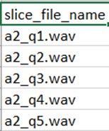
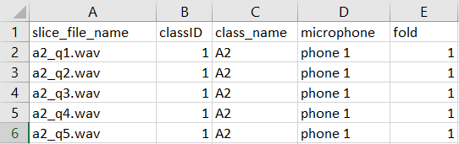
Format of Data and Metadata
Data collected in PCM.wav format (CD quality)
48,000kHz, 44,100kHz, 16,000kHz
Stereo and Mono Channel
16, 24 bit depth
Data name format
Metadata Format

Slide 28
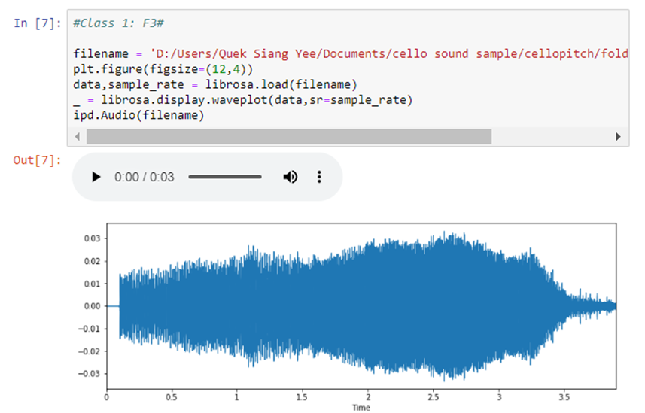
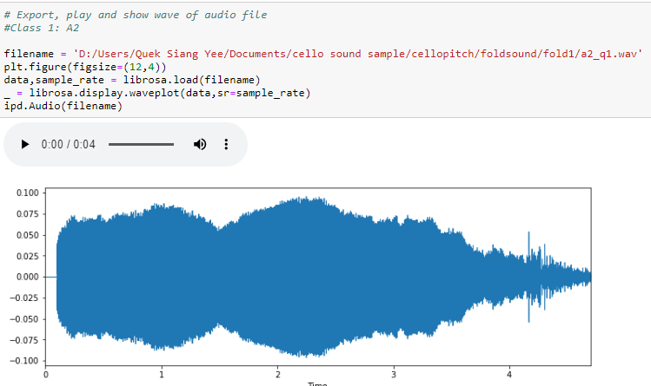
Data Visualize

Slide 29
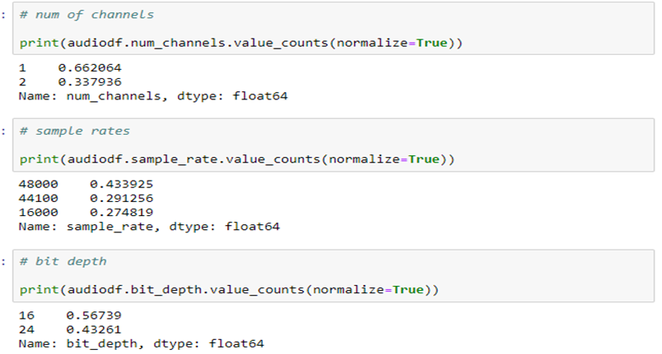
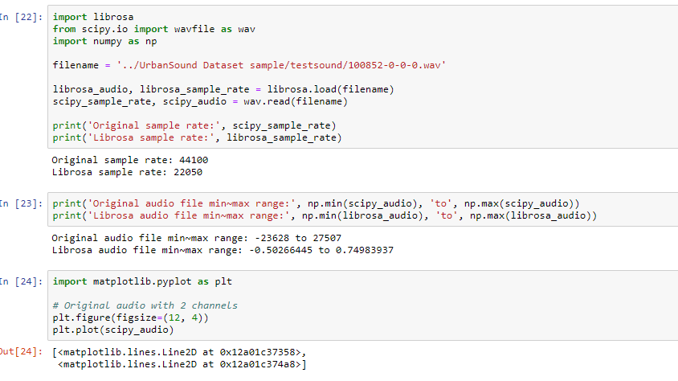
Data Preparation

Slide 30
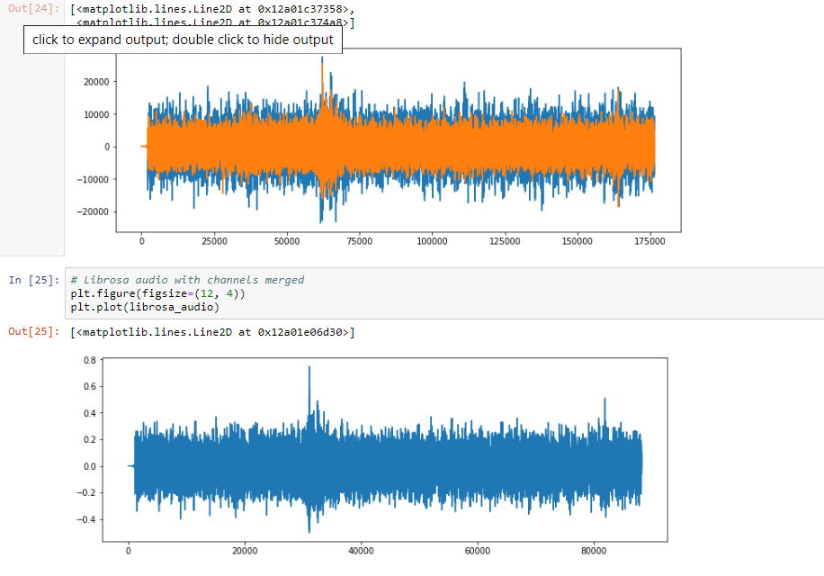
Data Preparation (cont.)

Slide 31
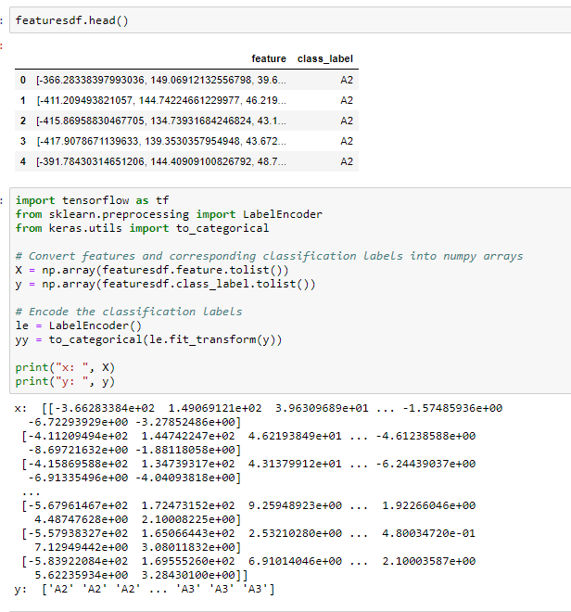
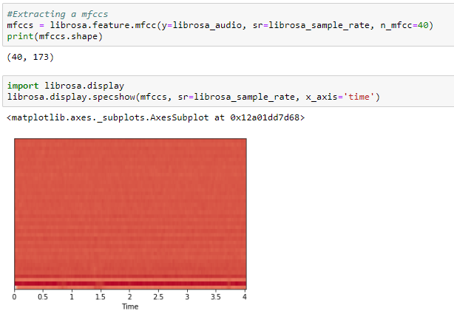
Extract Features and Integration
Features extracted and labeled

Slide 32
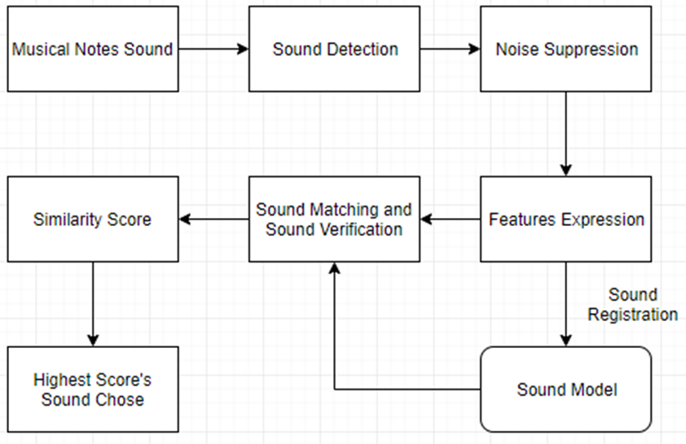
Process of Cello Pitch Recognition

Slide 33
Chapter 5
Implementation. Experimental setup. Dataset and Preprocessing, Results

Slide 34

Experimental Setup
Initial Model Architecture - MLP
Compiling
- each samples extracted 40 MFCCs which means have a input shape of 40.
- Loss function - we will use categorical_crossentropy. most common choice for classification.
- Metrics - allow us to view the accuracy score
- Optimizer - use adam which is a generally good optimizer
- 3 layers
- first two layer use ReLU, activation function of neural network
- output layer used softmax. Activation function of predictions, sum up to 1 so can be interpreted as probabilities
Notes:
Loss function - we will use categorical_crossentropy. This is the most common choice for classification. A lower score indicates that the model is performing better.
Metrics - we will use the accuracy metric which will allow us to view the accuracy score on the validation data when we train the model.
Optimizer - here we will use adam which is a generally good optimizer for many use cases.

Slide 35
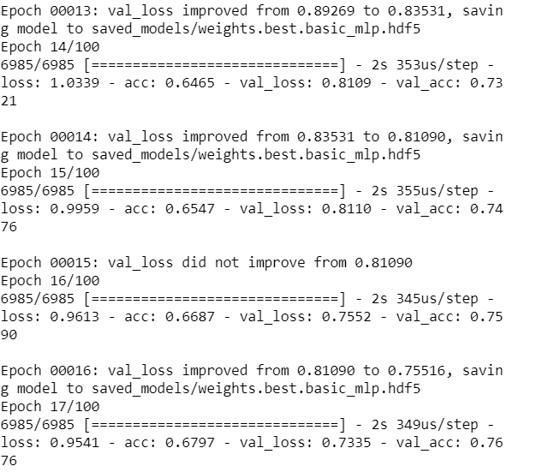

Experimental Setup (cont.)
Training
Train with 100 epochs: cycle 100 times through the data, model keep learning until reaches certain point
Testing
Review the accuracy of the model on both training and testing dataset after training phase

Slide 36
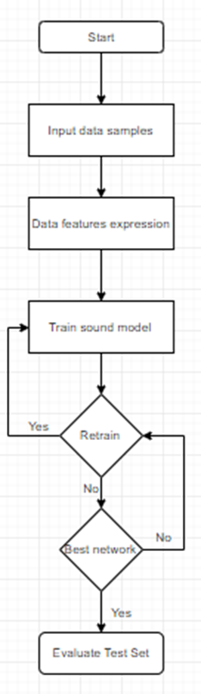
Flow of Training
MFCCs features of each data sound samples will be feed into the model
It will iterate the data sound samples until it satisfied.

Slide 37

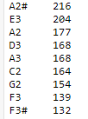
Dataset and Preprocessing
There are more than 1500 data sound samples have been collected
9 different classes of sound samples collected from 5 different sources
Data split into 80% for training and 20% for testing
100 epochs sets for training

Slide 38
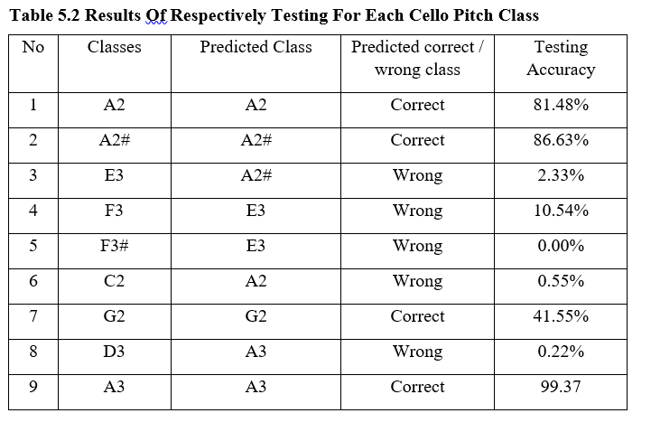
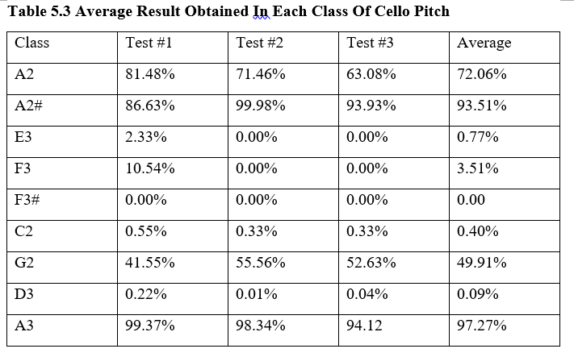
Results

Slide 39
Highest accuracy: A3 (97.27%)
Followed by A2# (93.51%) and A2 (72.06%)
Which means A sound is easier to extract MFCCs features/ clearer in MFCCs features
Observation
Back to last slide.
Low accuracy can caused by several reasons:
Similarities of extracted MFCCs
Unconspicuous MFCCs features
Octave of the sound
Loudness of the sound

Slide 40
Chapter 6
Conclusion. Research Conclusion. Future work .

Slide 41
Research Conclusion
Proposed a MLP model used to train open source datasets and self-collected datasets (cello pitch)
With this technology, it is possible to recognize continuous sound especially from A class of cello sounds where accuracy can up to 90%
This proposed study also capable to recognize sounds where without pre-processing which means the cello sound recorded by normal microphone (built-in microphone in smartphone/ computer)

Slide 42
Goal Achieved
1. To study how note recognizer can be built with machine learning techniques. This proposed system model used used to train and evaluate is MLP model (feedforward class of ANN)
2. To develop a prototype of note recognizer for learning and playing cello music accurately.
3. To test the proposed cello pitch recognizer based on accuracy. The overall training and testing result for the model, respectively result and the average result had been calculated and shown in this study. The highest accuracy could up to 90%.

Slide 43
Future Work
1. More tones and pitches to be trained inside this system.
2. Use other techniques to extract data sound features to increase the accuracy. (zero crossing rate, spectral centroid and etc)
3. Apply deep learning techniques such as CNN (Convolution Neural Network) train the datasets to produce better results.

Slide 44
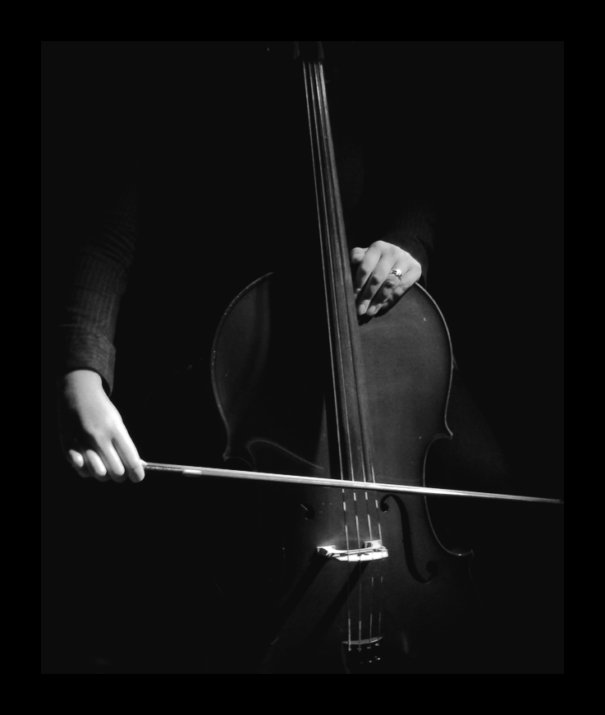
Q & A

